Slide 1
Specialized Middleware - NoSQL Databases
Srikanth Gunturu
Guest Faculty
BITS, WILP

Slide 2
In this segment
Specialized Middleware - NoSQL Databases
NoSQL Databases – Introduction
RDBMS Vs NoSQL DB
MongoDB – Overview
MongoDB - AWS

Slide 3
Specialized Middleware - NoSQL Databases
NoSQL Databases – Introduction
Deals with data that is modeled in forms other than tabular relations (as defined in relational data bases)
Large volumes of rapidly changing structured, semi-structured, and unstructured data
Geographically distributed scale-out architecture instead of expensive, monolithic architecture
Data types such as documents, images, videos, machine learning models etc.
NoSQL Data base types
Document databases
Graph stores
Key-value stores
Wide-column stores

Slide 4
Specialized Middleware - NoSQL Databases
RDBMS Vs NoSQL Database

Slide 5
Specialized Middleware - NoSQL Databases
MongoDB Overview
MongoDB is a document oriented DB following NoSQL paradigm
Released in 2009, latest version 4.0
Written in C++, Go, Python and Javascript
Offers a JS shell for all operations
Available as a standalone server and Cloud offering
Features
Adhoc Querying
Indexes
Replication
Speed and durability
Scaling

Slide 6
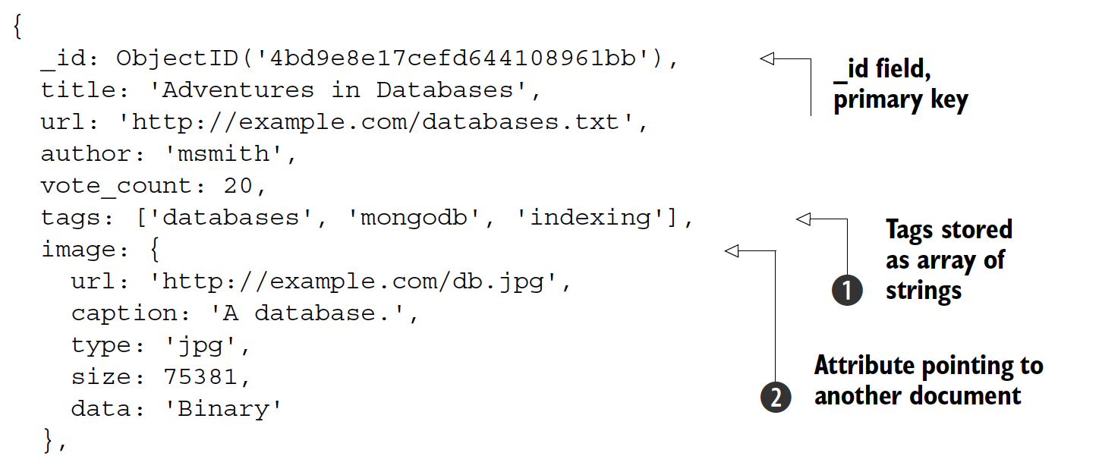
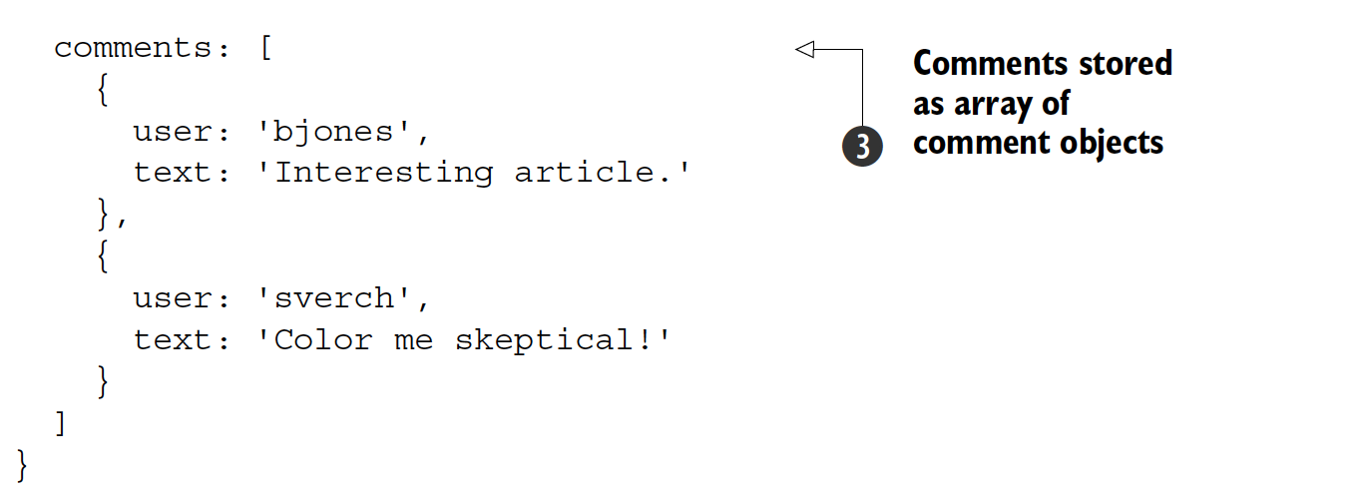
Specialized Middleware - NoSQL Databases
MongoDB – Document Data Model
Basic elements in MongoDB are: documents and fields

Slide 7
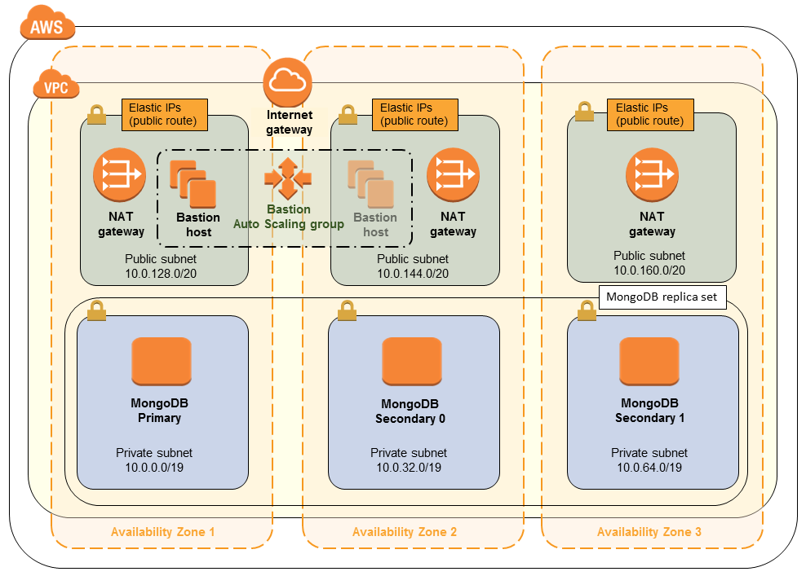
Specialized Middleware - NoSQL Databases
MongoDB – AWS

Slide 8
Specialized Middleware - NoSQL Databases
MongoDB – Installation & Configuration
Demo

Slide 9
Specialized Middleware - NoSQL Databases
MongoDB – AWS
Demo

Slide 10
Thank You!
In our next session:
Specialized Middleware - Caching

